Slide 1
UPJŠ Challenge
GOOD LECTURE TEMPLATE
Notes:
In this challange, we try to come up with a solution for the problem: „With a growing number of lecturers, how can the organisers ensure that new lecturers will also be able to deliver lectures of the same quality?”

Slide 2

WHOA!
Did you know that students have only 10 minutes of attention span, if the lecture is not intresting enough?

Slide 3


Two similarly experienced lecturers can have a notably different impact
Lecturer A
Lecturer B
Motivated students
Bored students
Notes:
….impact just because their presentation style differs. We believe that every lecturer can improve. (Moreover this kind of motivation and enthusiasm can determine a student’s carrier choice.)

Slide 4
What can you do to keep the motivation of your students?
The basic criteria must be provided for a good and interesting presentation.
To ensure a consistently high quality of lectures across multiple lecturers.

Slide 5
1. Interesting presentation
UNDERSTANDABLE
TARGET
CONNECTION
ILLUSTRATION
Speak coherently, thoughtfully.
Pace and style of the presentation has to fit the audience.
Involve the audience and monitor their reactions.
Diagrams, tables and figures help.
Notes:
First of all, have a logically built structure of the presentation. Speak coherently, thoughtfully, and make your point clear by highlight the keywords. Don’t forget about your target audience, as the pace and style of the presentation has to fit them. Watch their reactions and try to adapt to their needs. Diagrams, tables and figures help to visualize data.

Slide 6

Real life examples, personal experiences
Notes:
Share real life examples about the practical use of your topic, and personal experiences to draw attention. Students will be more motivated to work hard if they see the value of what they are learning.

Slide 7

A picture is worth a thousand words
Notes:
Remember, a picture is worth a thousand words, so always try to create a colorful, eye-catching presentation with many pictures, videos, and only the necessary amount of text.

Slide 8
2. Ensure consistently high quality of lectures
MENTOR
EXAMPLES
TEMPLATE
Website of all previous lectures with student feedback.
Uniform draft and design with a powerpoint based template.
who helps new lecturers to keep up with the standards.

Slide 9
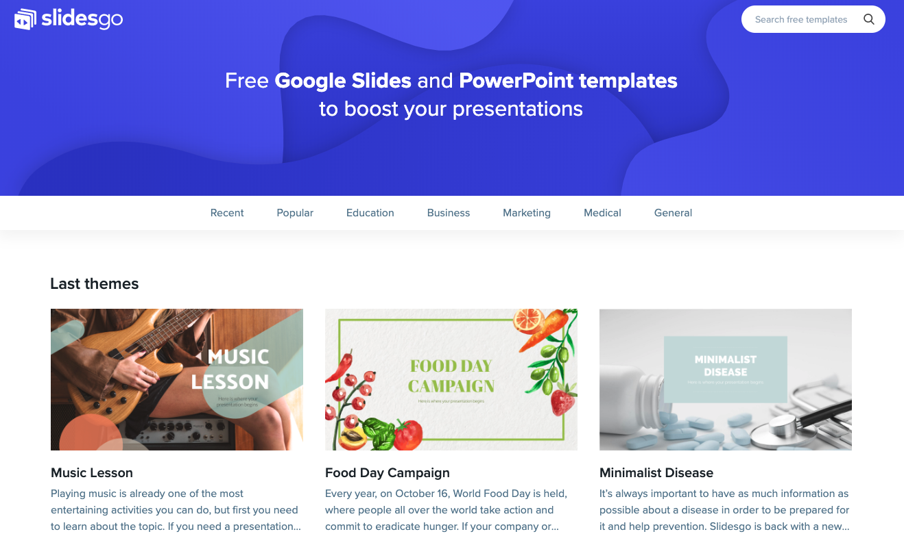

EXAMPLES IN DATABASE
On the webpage, you will find:
Presentations of previous lectures.
Students’ feedbacks
Educational videos and pictures for illustrations.
Useful experiences of the lecturers.
Notes:
We recommend creating a website, on which lecturers can share presentations and their experiences amongst themselves. This website could also contain the students’ feedbacks, materials for education like illustrations. This could greatly increase the quality of the lectures over time.

Slide 10
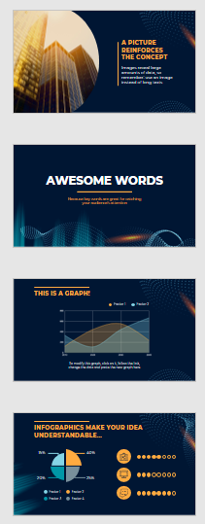
TEMPLATES
Pre-made slides to guide lecturers to use the suggested structure.
Helps to keep a uniform design.
Notes:
It’s important to note, that these are only suggestions for lecturers to build upon, and can be adjusted easily to the current presentation. The main goal is to have a uniform design of the lectures.

Slide 11

MENTOR
Notes:
Mentors could integrate newcomer lecturers into the project, and help them to apply the presentation guidelines, give ideas, tricks and tips to make presentations better. They could oversee the lecturers and raise their attention if the quality of their lectures doesn’t meet the required standards.

Slide 12
SUMMARY
INTERESTING
EXAMPLES
TEMPLATES
MENTOR
With the help of these ideas you can maintain a consistently high quality of the lectures.
presentations
on a webpage from previous presentations
as guidelines
who helps in practice
Notes:
To sum everything up, we offer the following ideas:
The teachers should implement the mentioned guidelines in their presentations to make it more interesting for students.
A website of examples and teaching materials should be created, to help lecturers.
A uniform presentation design should be created.
The launch of a mentor program would be greatly beneficial.

Slide 13
THANKS!
Please keep this slide for attribution.
Notes:
Thank you for your attention. You can find more details about our proposed solution on our GitHub page.

